Slide 1
Dashboard Automation: Contract & PO Reporting
Carmen Lu

Slide 2
Background/Problem
Manually Process
Data was manually exported from DAS to Excel and then imported into Power BI to refresh the dashboard.
Goal - To automate the data pipeline to achieve:
Reduce manual effort
Time-saving
Up-to-date data

Slide 3
What I Did
Designed a SQL query based on DAS Design Notes and embedded it directly into Power BI.
The query connects to SQL Server and joins multiple source tables (e.g., F4301, F4311, F0101, F0006, F0005, F0092) SQL Scripts
Notes:
Currently, PowerBi can’t auto refresh is using Python script, so I chose SQL query to make sure data auto refesh. Data Lakehouse is coming, but we can make some changes with that.

Slide 4
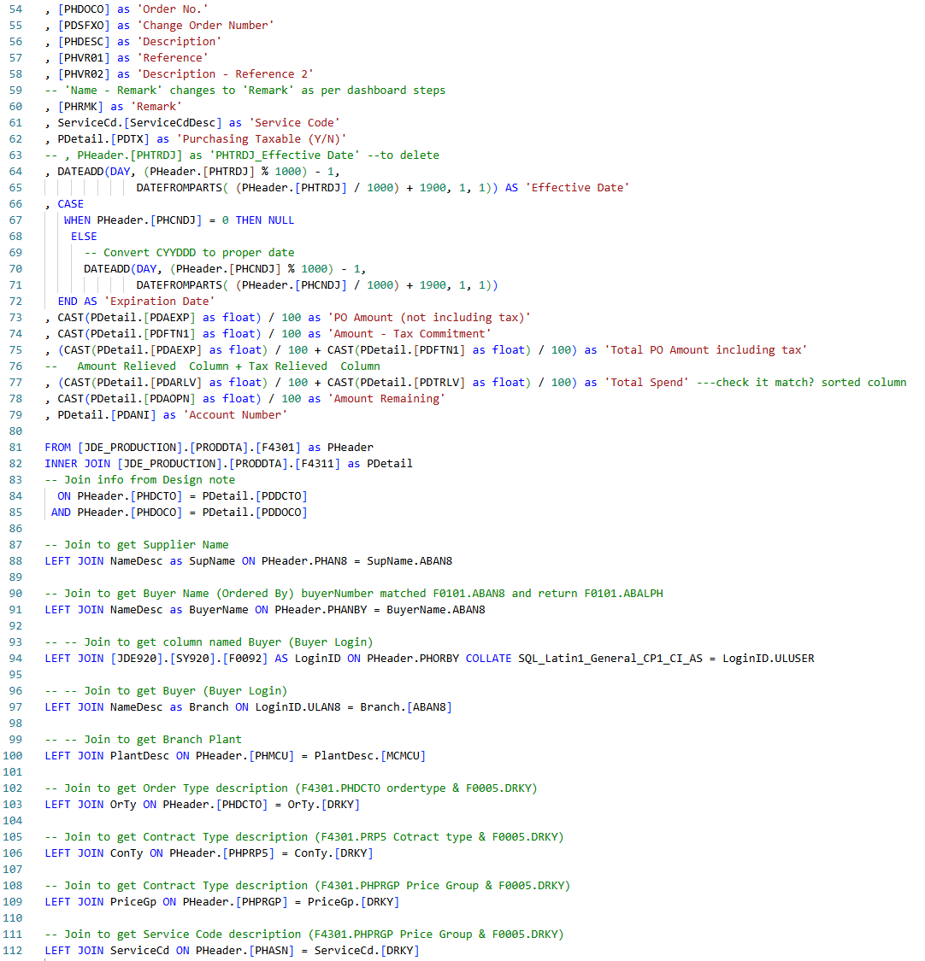
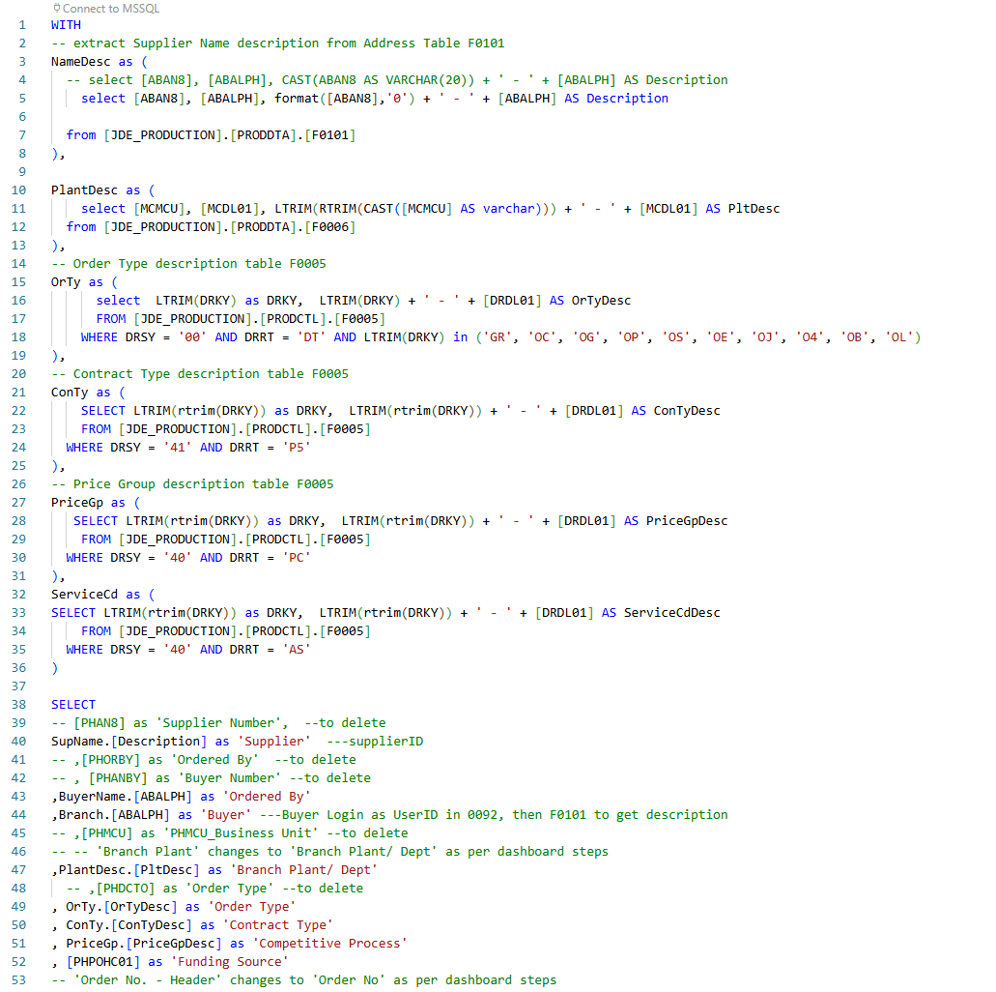
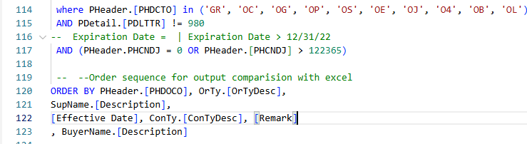

Slide 5
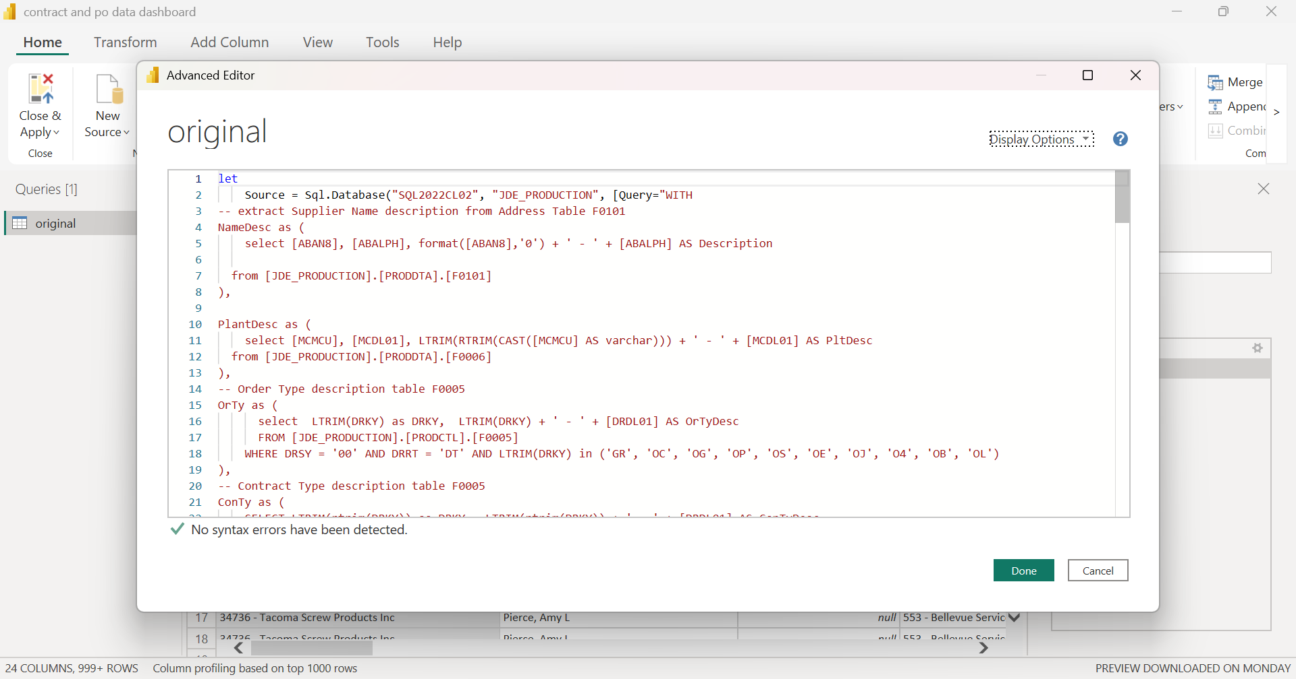

Slide 6
What I Did
Designed a SQL query based on DAS Design Notes and embedded it directly into Power BI.
The query connects to SQL Server and joins multiple source tables (e.g., F4301, F4311, F0101, F0006, F0005, F0092) SQL Scripts
Data Validation: Making sure SQL output matches the DAS Excel report
Automated data import from the database
Scheduled data auto-refresh set to twice per week for testing and no issues

Slide 7
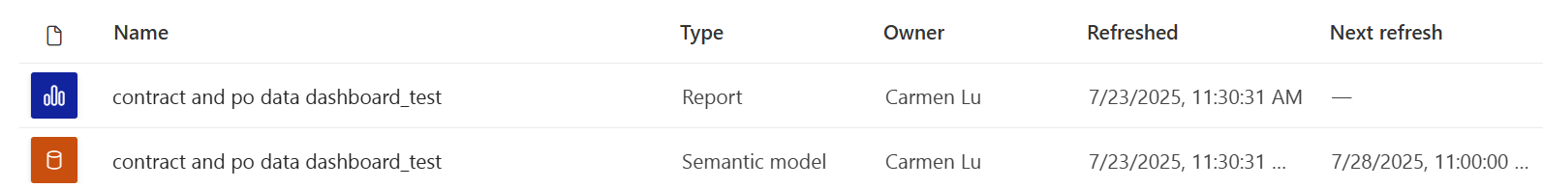
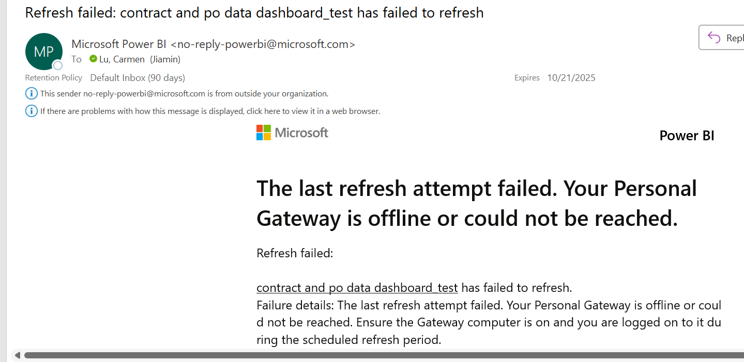
Auto Refresh Schedule Setting:
Refresh failure notification via email:
Currently using personal gateway:
If my laptop is off during scheduled refresh, data refresh will fail.
Will check with Emily to see if Enterprise Gateway is available for the FAM workspace.

Slide 8
Results
Resolved error where the DAS report included a summary row, which led to double-counted totals

Slide 9
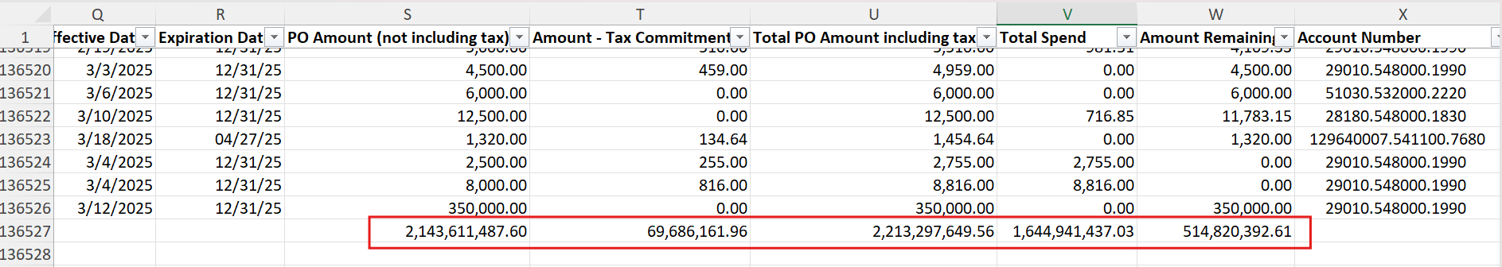
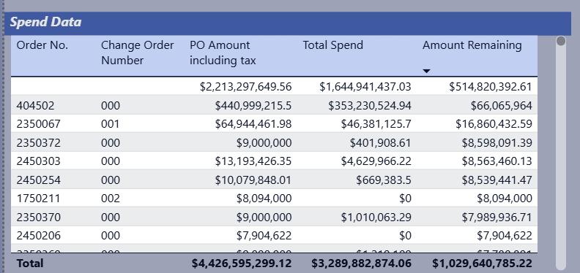
The original DAS report includes a summary row that caused incorrect totals in Power BI
Caused double counted totals
Using SQL - ensuring accurate aggregation

Slide 10
Results
Resolved error where the DAS report included a summary row, which led to double-counted totals
Dashboard now pulls real-time data directly from the database
Manual Excel exports are no longer needed
Minimize errors
Scheduled refreshes ensure regular updates

Slide 11
Challenges
Missing source tables in DAS Design Notes—I had to identify and test them manually
Lack of access to key tables like F0101 and F0092
Output discrepancies between my saved DAS query and Michael’s DAS query took time to troubleshoot
Notes:
Description is a built-in function in DAS,

Slide 12
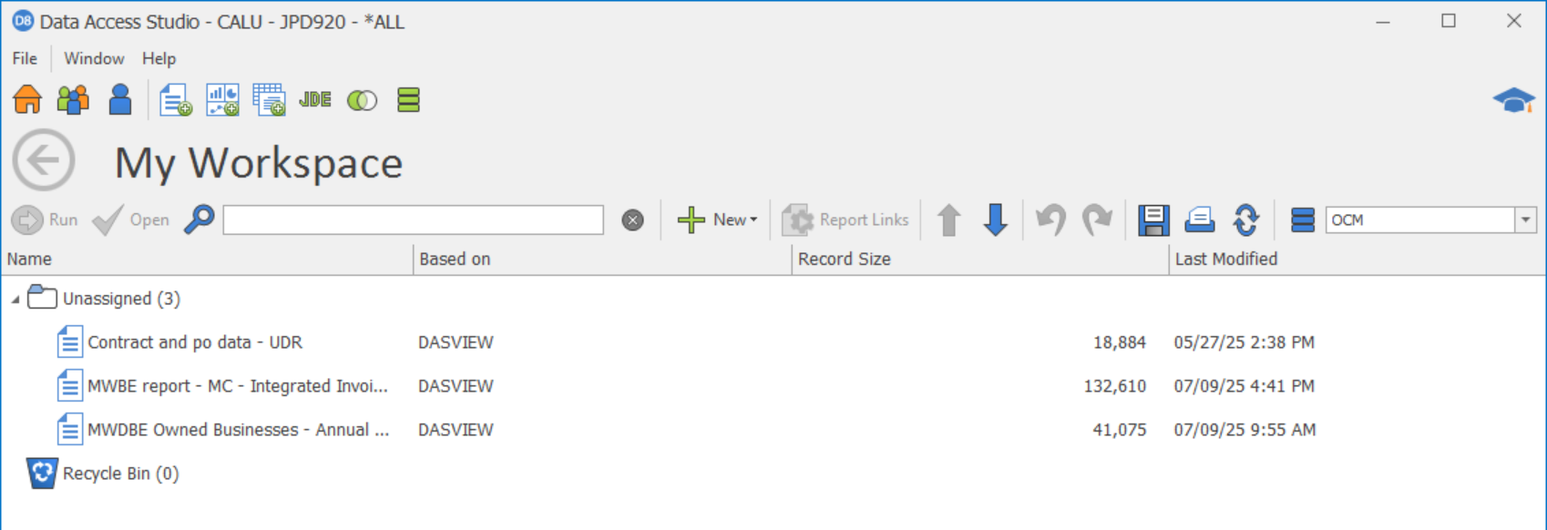
Copied Michael’s data query in DAS to My Workspace

Slide 13
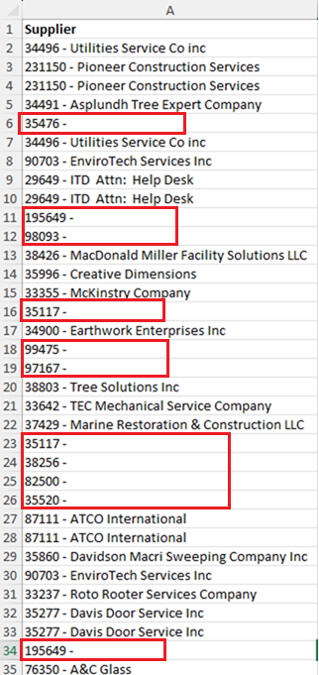
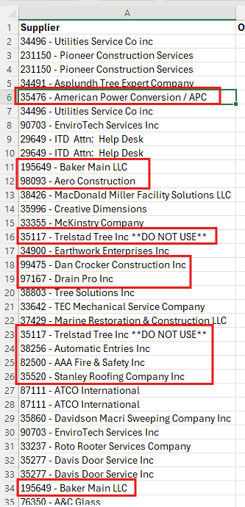
Report exported from DAS
Report exported using SQL query from Database
Part of supplier description were missing

Slide 14
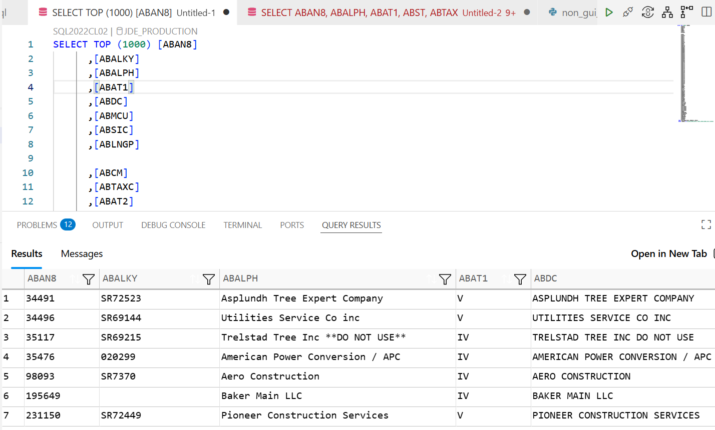
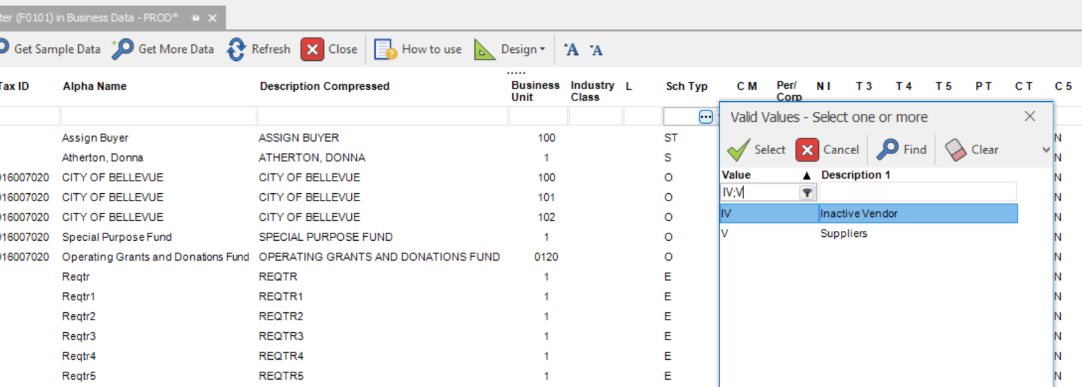
The missing is because inactive vendors were somehow filtered out.
But Michael’s excel report is a complete list.
Mistake:
I assumed the output should be the same since I just copied your query.
Lesson learned:
Always double-check the output from DAS reports, even if the query is reused

Slide 15
Next Steps
To publish the finalized dashboard to FAM workspace? – happy to coordinate with Emily
Refresh frequency: Daily or weekly?
Confirm who should receive refresh failure notifications: Carmen only, or both Carmen and Michael?

Slide 16
Thank you!

